Slide 1

DEMS Integration – POC Findings and Recommendation
For Technical Review and Discussion Jan 19, 2022
Prepared by Jennifer Dowd and David Agahchen

Slide 2

Agenda
Integration is complex!
Current state of our integration architecture
Modern Integration Pattern and Architecture
Our Recommendation
Why is this not another webMethods
What’s included in the Red Hat Integration Toolkit
How the toolkit meets the needs of the DEMS project

Slide 3
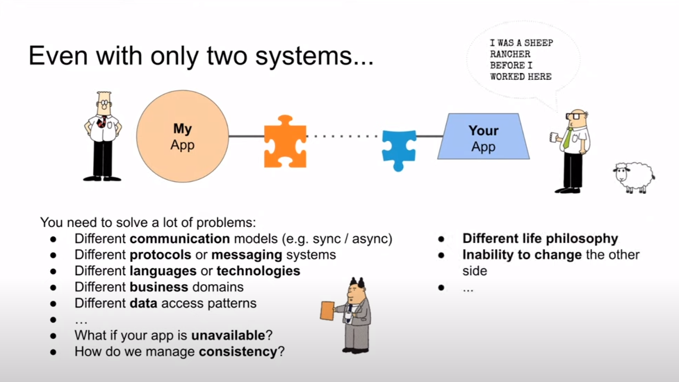
Integration is Complex!

Slide 4
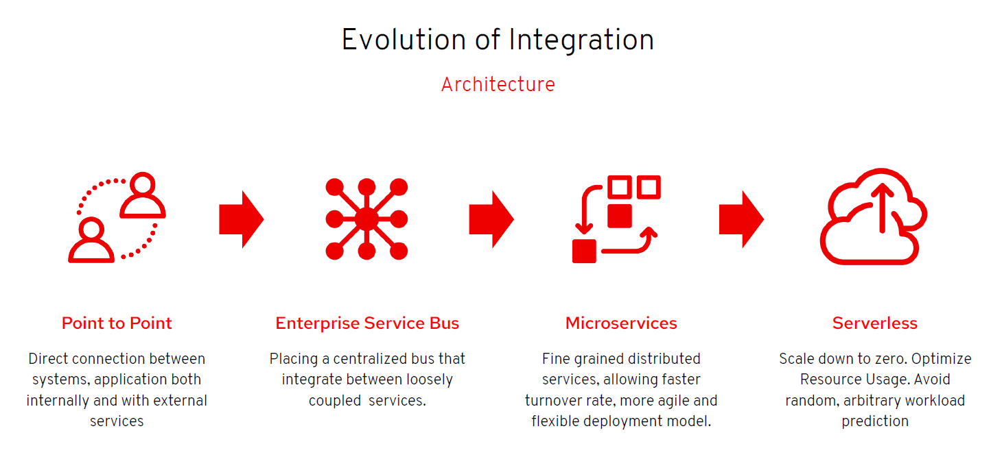

We are here with Webmethods

Slide 5


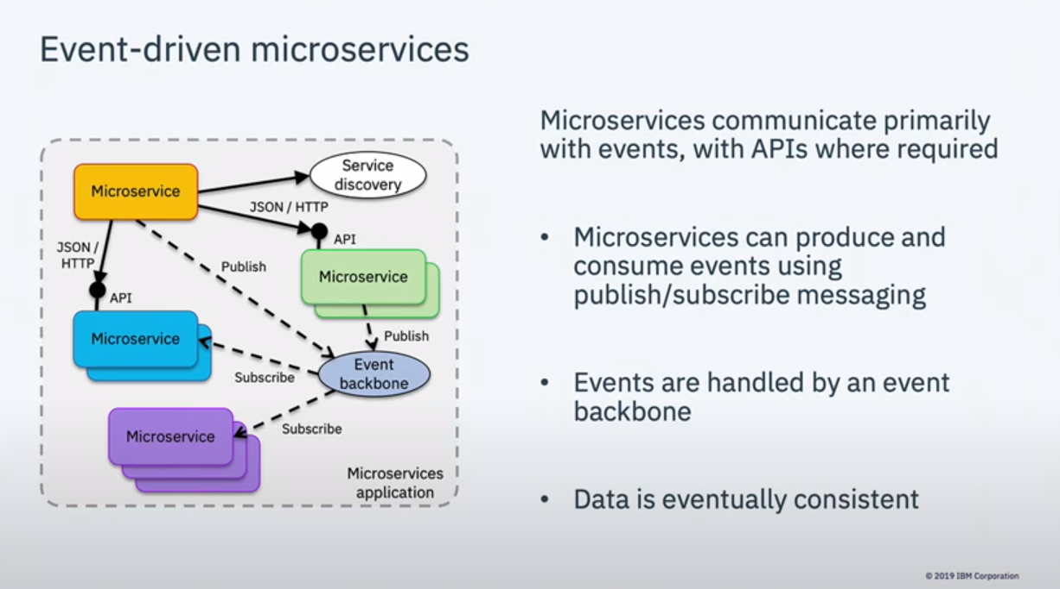
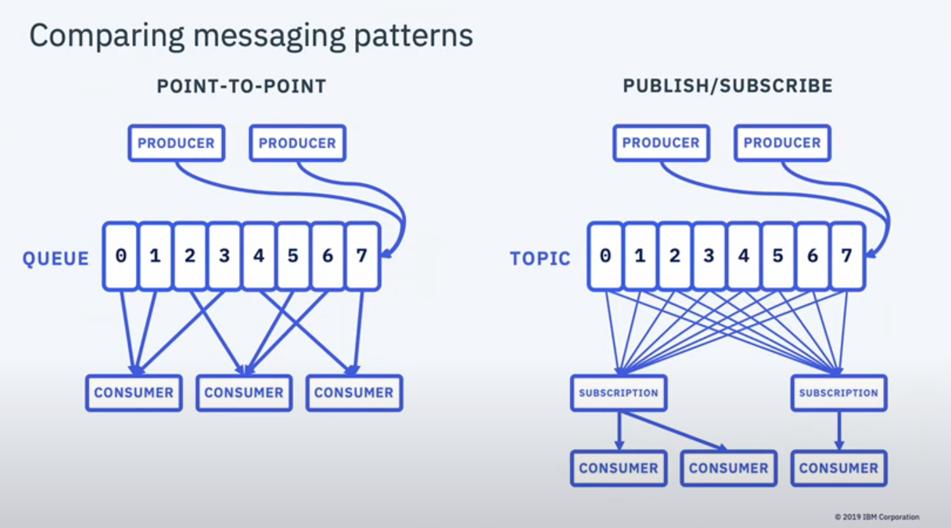
Modern Integration Pattern and Architecture
The future of integration is event-driven microservices

Slide 6

Our Recommendation
Benefits with Red Hat Integration
- Automation – Operator-assisted deployments and run time.
- Just Integration Code – Packaging and Deployment Managed Separately.
- Open Source – Built on best-of-breed open source solutions.
- No Vendor Lock-In – each toolkit can co-exist or be replaced with alternative solutions.
- Agile Integration Stack – best practice design and implementation for event-based IT.
- OpenShift Friendly – Out of the box native support for OpenShift.
- Product support – Access to Red Hat product support and new releases.
Things to be aware of with Red Hat Integration
- Leading Edge Technology – Some integration toolkits are either only recently became generally available (GA) or are still in technical preview.
- Lacking Centralized Documentation – While Red Hat has provided much documentation on their developer site, the fact is, each open source project leveraged by the integration toolkit has its own documentation and versioning. - This adds to the complexity and learning curve for new integration developers and architects
Dependencies
- Red Hat Integration toolkit relies primarily on OpenShift operators. This means that the integration delivery services team will need to coordinate with the OCP platform team in order to make cluster-wide changes to the toolkit operators.
- The OCP platform team will need to monitor and report on integration toolkit licensing compliance for the entire cluster.
OUR RECOMMENDATION
IMPLEMENT THE RED HAT INTEGRATION TOOLKIT for the DEMS Project

Slide 7
Why this is not another webMethods
This is not a centralized, vendor lock-in ESB
webMethods implements a classic centralized enterprise integration solution (ESB), which does not natively support DevOps / agile delivery. Using an ESB requires that the ESB’s tools are used for the entire life cycle, in addition to whatever tools used in the development and operations environments. This limitation leads to awkward, inefficient, and error-prone operations. Red Hat Integration implements distributed integration instead.
Next Gen (Distributed) Integration
Distributed integration achieves many of the same technical objectives of previous generations of ESBs, but in a way that is more adaptive to teams within an organization. As with ESBs, distributed integration technology offers transformation, routing, parsing, error handling, and alerting capabilities
Event Driven
webMethods, like other classic ESB solutions, focuses on API-based integrations only. Red Hat Integration focuses on event-based integration, with the ability to implement synchronous (API-based) integration when needed. Being even-driven is different. Rather than IT being the enterprise information repository, event-driven allows IT to be the digital business nervous system for the enterprise.
Integration Delivery Service Team is KEY to Success
webMethods requires a specific skill set that is not highly available
With Red Hat Integration Support, you get highly desirable skills from the supplier and vendor teams and a that are always improving

Slide 8

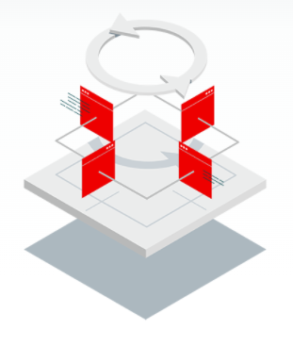




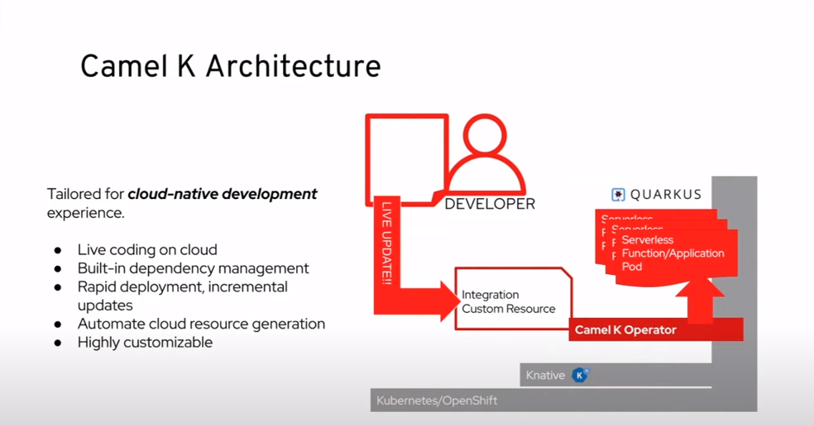
What is included in the Red Hat Integration Suite
Red Hat Runtimes – Red Hat Runtimes is part of the Red Hat Application Services portfolio. Red Hat Runtimes is a set of products, tools, and components for developing and maintaining cloud-native applications. It offers lightweight runtimes and frameworks (like Quarkus) for highly-distributed cloud architectures, such as microservices.
Events and messaging with Red Hat AMQ Streams – Red Hat AMQ Streams is a massively scalable, distributed, and high performance data streaming platform based on the Apache Kafka project. AMQ Streams provides an event streaming backbone that allows microservices and other application components to exchange data with extremely high throughput.
Integration with Red Hat Fuse – Based on open source communities like Apache Camel and Apache ActiveMQ, it allows teams to deploy integrated services where required. The API-centric, container-based architecture decouples services so they can be created, extended, and deployed independently to implement microservices style architecture. Connect applications, data and APIs across SaaS apps, Cloud apps, on-premise apps. This includes the Camel K integration platform built on the latest cloud-native Apache Camel solution.
Change Data Capture – Debezium is a distributed platform built on Apache Kafka that turns your existing databases into event streams, so applications can see and respond immediately to each row-level change in the databases.
Service Registry – Service Registry is a datastore for sharing standard event schemas and API designs across API and event-driven architectures. You can use Service Registry to decouple the structure of your data from your client applications, and to share and manage your data types and API descriptions at runtime using a REST interface.
Notes:
More details available at Red Hat Marketplace: https://marketplace.redhat.com/en-us/products/red-hat-integration/includes
Also included with Red Hat Integration Suite is the Red Hat 3scale API Management – an infrastructure platform on which to share, distribute, control, monetize, and provide security for APIs. An effective API management solution is key to implementing API-first, flexible integrations. The integration services team is working with API Programme Services (APS) in adopting the corporate API catalog and management services powered by the Kong product suite.
https://developers.redhat.com/products/3scale/overview

Slide 9

How the Red Hat Integration Toolkit meet
the requirements of DEMS Project

Slide 10
Integration Service Layer for the Court Case Management Domain – CURRENT SOLUTION ARCHITECTURE
JUSTIN
CORNET
JUSTIN Utility Adapters
CORNET Utility Adapters
Examples
Create case
Update case asset
Example
Accused history list
Example
User / court case access
permission
Examples
Eligibility status
Bulk eligibility status
Example
Readiness notification
Notification delivered
Court Case Notification Service (Queues)
Court Case Lookup Service (APIs)
User Access Lookup Service (APIs)
e-Disclosure Eligibility Lookup Service (APIs)
e-Disclosure Readiness Notification Service (Queues)
POC Scope
Integration
Pattern #2
Integration
Pattern #1
Integration
Pattern #2
Integration
Pattern #1
Integration
Pattern #3
DEMS Edge Adapters
DEMS Utility Adapters
DEMS

Slide 11
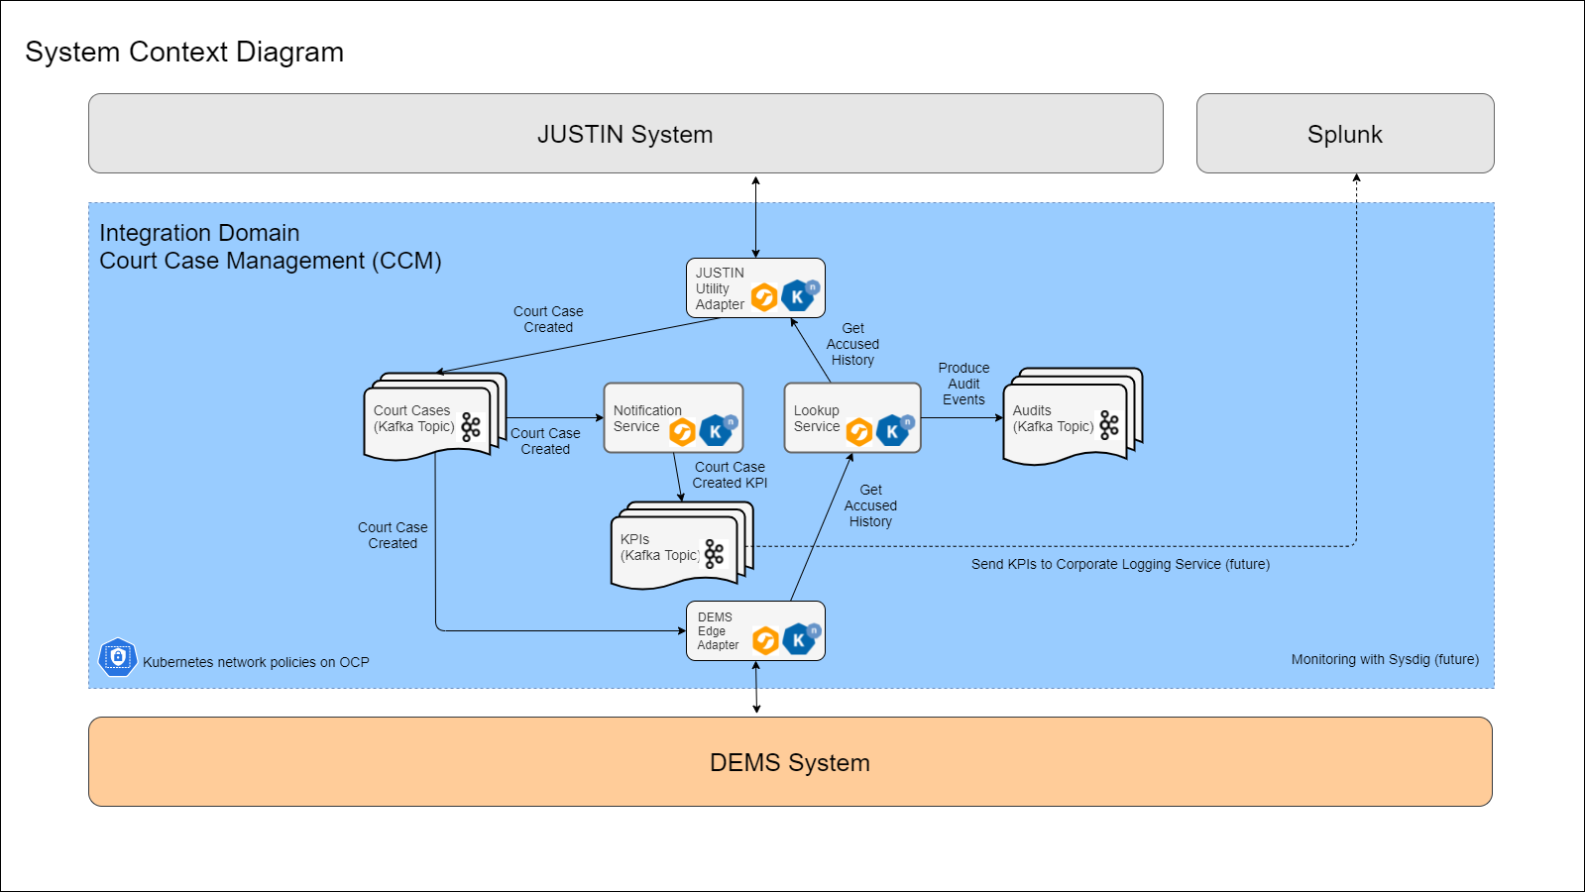
Event Based, API-First DEMS Integration POC
Event Model
Events / Commands
Court Case Created
Get Accused History
Actors
JUSTIN System
DEMS User
API-First Domain Services
Notification Service
Lookup service
Event Topics
Court Cases
KPIs (non-personal key performance indicators)
Audits
1.1
2.3
2.2
1.3
1.2
2.1
Data Flow and Business Activities
When a new court case is created in the JUSTIN system,
JUSTIN System produces the business event that a new court case has been created
Notification Service processes the event and extracts KPI data
DEMS System re-creates the court case based on the business event and makes the data accessible to authorized users
When a DEMS user requests accused history related to a court case,
DEMS System issues a command (via API call) to Lookup Service to retrieve accused history
Lookup Service creates an audit record (user id, court case #, timestamp) prior to forwarding the request to JUSTIN System
JUSTIN System accepts or denies the lookup request according to internal access policies and audit requirements, and provides accused history if request is valid
GitHub Repo: https://github.com/bcgov/jpss-redhat-integration-poc
Notes:
A business event records the fact that “something happened” in the business. While a command is a synchronous API call from one system to carry out a business task in another system.
This JUSTIN / DEMS integration proof-of-concept demonstrates the following business activities and the corresponding processing:
When a new court case is created in the JUSTIN system,
JUSTIN System produces the business event that a new court case has been created
Notification Service processes the event and extracts KPI data
DEMS System re-creates the court case based on the business event and makes the data accessible to authorized users
When a DEMS user requests accused history related to a court case,
DEMS System issues a command (via API call) to Lookup Service to retrieve accused history
Lookup Service creates an audit record (user id, court case #, timestamp) prior to forwarding the request to JUSTIN System
JUSTIN System accepts or denies the lookup request according to internal access policies and audit requirements, and provides accused history if request is valid

Slide 12
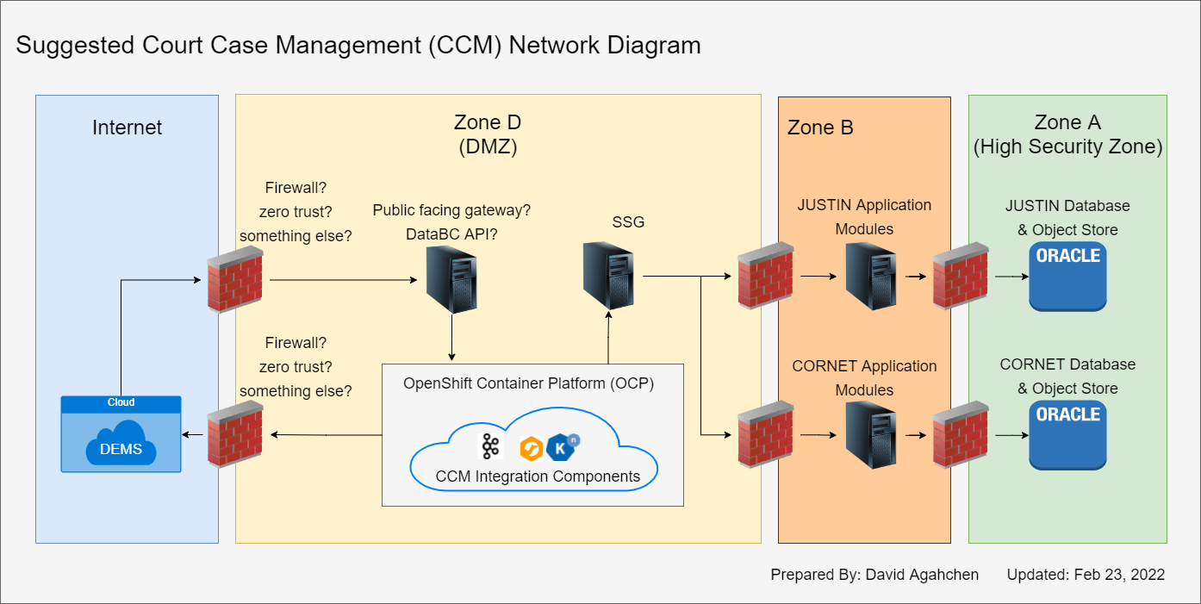
Proposed DEMS Integration Solution Network Diagram

Slide 13
Proposed Integration Roles and Responsibilities
Role | Responsibilities | Fulfilled By Team(s)
Define a business domain | Model the events and commands available for enterprise integration | Business Area Application Integration Services
Develop integration components | Develop new or extend existing adapters, services, APIs and schemas | Application Integration Service
Approve integration changes | Review and approve integration changes | Business Area Application Integration Services Security
Deploy integration components | Deploy new or updated adapters, services APIs and schemas | Integration Services
Monitor integration components | Monitor integration components and maintain integration stack upgrades | Integration Services

Slide 14
Will It Scale?
The event based, API-first integration design we are proposing is scalable in several ways.
Reusable – events and commands (APIs) developed for one integration can be consumed / called in another integration. E.g., develop once, use many times.
Extensible domain modeling – Event schemas and command APIs can be extended and changed, while maintaining backward compatibility without impacting existing integrations or the associated applications. E.g., rather than creating perfect event schemas and command APIs in one go, the designs and definition can iterate and improve over time.
Alterable – Integration design and logging / auditing rules can be changed without involving the impacted application teams. E.g., integration logic can be changed independently from application logic, minimizing overhead and dependencies between applications.
Modular – The event based microservice design means that each domain service and event topic can evolve independently from the rest of domain services. E.g., this means multiple integration work can take place concurrently without impacting each other.

Slide 15
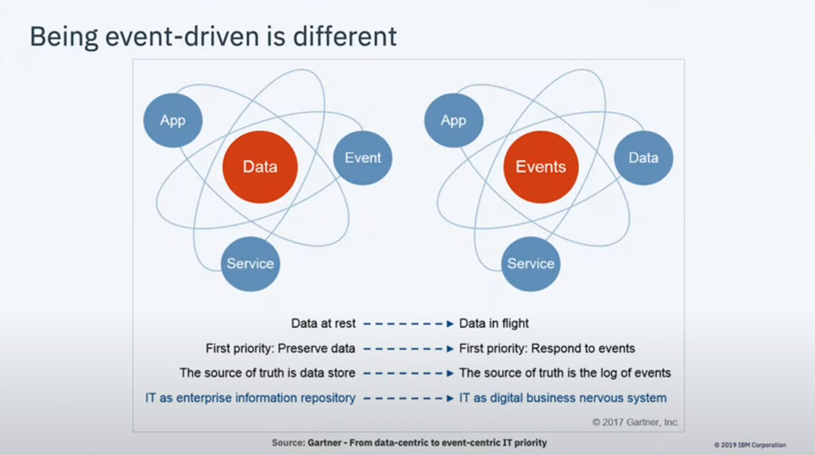
Future Role of IT
The ultimate question is, will IT remain the sector’s information repository, or will IT become the business nervous system for the digital government?

